Slide 1
Class Testing from OCL Class Contract Specifications Using Evolutionary Multi Objective Genetic Algorithms
Supervised by Mr. Atif Aftab Ahmed Jilani
(Assistant Professor, FAST NU)
Co Supervised by Mr. Syed Saqulain
(Assistant Professor, IIU)
By Rehan Farooq
119-FAS/MSSE/F06

Slide 2
Agenda
Introduction and Background
Current State of the Art (Literature Review)
Litterateur Evaluation and Identified Problems
Our Approach
AFSM Buildup from standard OCL
MOGA based test sequence optimization
Designing of Coding scheme
Designing of Multi-Objective Fitness Functions
Selection of Initial Population
Setup and Execution
Experiment and Case Study
Conclusion and Future Work
References

Slide 3
Introduction and Background (Cont.)
Test Sequences (Synonymous to Test Cases)
Sequence of System Under Test (Class Under Test) interactions (method invocations) with testing environment, synonymous to Test Case.
Including the set of input parameters and expected results.
Generated test sequences give the sequence of method invocations to test methods of a class.
This sequence is in which methods are invoked while testing the class interfaces is important.

Slide 4
Introduction and Background (Cont.)
Test Sequences from OCL Class Contracts
Literature shows that [1]
Test Sequences for a unit testing of a class can be generated from its Class contract specifications [1].
Structural and Behavioral aspects
Class Model covers the Structural or static aspect
Class Contracts cover Behavioral aspect
Class Specifications give Test Sequences, which are then executed against that particular Class.
In particular, sequence of method invocation is critical in testing
Unit testing of class requires specific method call sequence to put the object in specific state
A valid method’s call from an invalid state might give wrong results

Slide 5
Introduction and Background (Cont.)
Why Optimize State-based Test Sequence?
A large number of possible test sequences may require
Exponential time and
Effort for the testing process itself.
Many of the generated test sequences can be either
Infeasible/repetitive/reoccurring possibly several times or
Might not be required at all.
It is not practical and, in general, impossible to asses all the possible test sequences of program flows due to effort and time required for execution.
There is always a tradeoff between
Number of generated test sequences (Cost) and
The achieved Test Coverage.
It is quite difficult for a machine to evaluate all test sequences within a reasonable amount of time.
Exhaustive testing of all the test sequences is impossible.

Slide 6
Introduction and Background (Cont.)
Evolutionary Multi-Objective Genetic Algorithms
Evolutionary Algorithms (EA) are inspired by the natural selection phenomena “Survival of the Fittest”.
GAs comprise of
Initialization (initial population of possible solutions)
Selection (genomes chosen from population for future breeding)
Reproduction
Crossover (interchange of part of parent solutions to get offspring)
Mutation (change parts of offspring to avoid local optimum)
Termination (Selection and Reproduction is repeated till a termination condition)
Multi Objective Genetic Algorithms
A kind of Genetic Algorithms where we try to optimize for more than one (possibly contradicting) objectives.
Output is a Pareto optimal set of solutions where each solution is optimized for keeping in view more than one fitness functions.
Test sequence cost and coverage are conflicting constraints which can be optimized using MOGAs

Slide 7
Current State of the Art (Literature Review)
Authors | Automation | Specification Based | Coverage | State Based | Optimization | Multi Objective
Atul Gupta [1], Springer (2010) | Automation is hard due to non-standard OCL syntax | Yes, from OCL specifications | -Transition Tree Coverage | Yes, suffer from State-based problems | X | X
Marie-Claude Gaudel [14], Springer (2001) | Semi Automation | Yes, LOTOS based proof of concept on Possum. | -All paths coverage | Yes, test sequences are generated from directed graph | X | X
Thaise Yano et al [2], ICSTW, IEEE (2010) | Partial automation does not discuss in which form the model will be taken. | X | -Target Transition Coverage | EFSM is used as an intermediate form | Yes, an Optimization Algorithm, which is strictly not GA based. | Yes
Mark Harman et al [4], ISCTW, IEEE (2010) | X | X | X | Yes an EFSM based representation is used | Three Test data optimization algorithms are proposed | X
S. Asthana et al [6], Springer (2010) | Automation without using an intermediate model. | X | X | Yes , and claim to have avoided state space explosion because their model is executable | X | X
S.K. Prasad et al [8], ICISTM, Springer (2009) | Claim automatic approach for generating test data | X | X | X | Yes optimization through single objective GA | X

Slide 8
Current State of the Art (Literature Review) (Cont.)
Approach | Automation | Specification Based | Coverage | State Based | Optimization | Multi Objective
S.K. Prasad et al [8], ICISTM, Springer (2009) | Claim automatic approach for generating test data | X | X | X | Yes optimization through single objective GA | X
S.K. Prasad et al [9], ICISTM, Springer (2009) | Automation of test sequence generation process is claimed. | X | -All state coverage | Yes, FSM is generated. | Yes ,Ant Colony based Optimization | X
M. Prasannan and K.R. Chandran [10], ICSRS (2009) | Automation of test case generation is claimed. | X | X | General Tree and Tree Structure are built and depth-first search gives test sequences | Cross Over of GA is used, but optimization is not mentioned. | X
Chen Mingsong et al [12], ACM (2006) | Yes from UML Activity Diagram | X | -Activity -Simple Path -All Transition | Yes, UML Activity Diagram as Directed Graph. | X | X
K. Derderian et al [13], ACM (2006). | Yes | X | X | Yes, Approach is specifically for FSMs | Yes, GA based optimization | X

Slide 9
Litterateur Evaluation and Identified Problems
Lack of Automation & Deviation from Industry Standards
Approaches found in the literature
Either don’t provide any automation at all (assuming the input in a predefined state/format)
Or Fail to comply with the sate of the art industry standards like e.g. deviation for the standard syntax
It makes it hard for test engineers to used these techniques
Software requirements and hence specification are quite often volatile, automation can be a great help to regenerate the test sequences from changing specifications.

Slide 10
Litterateur Evaluation and Identified Problems (Cont.)
State based problems
A large number of possible test sequences may require
Exponential time and
Resources for the testing process itself.
Many of the generated test sequences can be either
Infeasible/repetitive/reoccurring possibly several times or
Might not be required at all.
It is not practical and, in general, impossible to asses all the possible test sequences of program flows due to effort and time required for execution.
There is always a tradeoff between
Number of generated test sequences (Cost) and
The achieved Test Coverage.
It is quite difficult for a machine to evaluate all test sequences within a reasonable amount of time.
Exhaustive testing by all the possible test sequences is impossible.

Slide 11
Our Approach
OCL Parse Tree
OCL Class Contracts
Standard OCL Parser
OCL Semantic Analysis
Abstract Finite State Machine
Selected Raw Test Sequences
Exhaustive Search
Multi Objective Genetic Algorithm
Optimized Test Sequences

Slide 12
Our Approach
AFSM Buildup from standard OCL
OCL Parsing and Parse Tree Generation
Parsing using industry standard OCL Parser
Construction of Parse Tree of Syntax
Semantic Analysis & AFSM Buildup
The OCL parse Tree is scanned for semantics
Defined rules are interpreted and following the approach used in [1] we get corresponding AFSM
This process automates the buildup of Abstract State Machine(AFSM) from standard OCL class contract.

Slide 13
Our Approach (Cont.)
MOGA based test sequence optimization
Encoding of Genes and Chromosomes
We directly encode the transitions into the chromosomes
Each Gene represents a method call/transition (having from and to states)
Each Chromosome is in turn a sequence of method calls/transitions.
So a chromosome of length n will have n method calls and each method call has a from and to state reference to AFSM.
M1 | M2 | M3 | … | M_{n}

Slide 14

Our Approach (Cont.)
The fitness functions
Calculate Fitness By Coverage (1)
If a transition is covered once chromosome is given additional positive weight-age, it rewards a chromosome for covering a transition.
If a transition is not covered at all by a chromosome it is given additional negative weight-age, it reward a chromosome negatively for not covering a transition.
If a transition is covered more than once by a chromosome it is given additional negative weight-age, it rewards negatively due to repetition.

Slide 15
Our Approach (Cont.)
The fitness functions
Calculate Fitness by Validity (2) (chromosome has to have method calls in valid sequence)
Initial state weight, if the first gene of the chromosome has an initial state of AFSM as from state then this weight is added else skipped.
Sequence weight for call sequence, we calculate the quality of chromosome by the sequence of method calls and reward each chromosome by following formula
If any of the method calls (genes) is in a valid sequence then a positive weight is added to the second fitness value.
If any of the method calls (genes) is not in a valid sequence then a negative weight is added

Slide 16
Experiment and case study
Aims and objectives of Case Study
To Investigate into a case of test sequence generation using our new approach
How our approach improves the test sequence generation process by
Adopting the approach to meet industry Standards and
Automating the test sequence generation process
What are the improvements of our approach in terms of quality of test sequences
What are pitfalls and Observations of MOGA for test sequence optimization

Slide 17
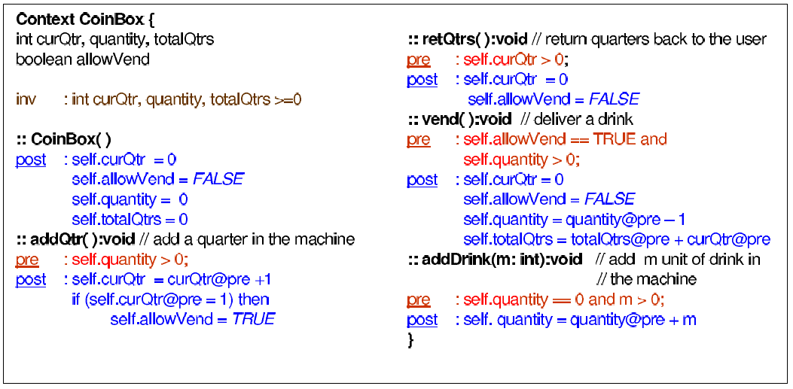
Automation and case study (Cont.)
Previous Non-standard OCL Syntax [1]

Slide 18
Automation and case study (Cont.)
Some of the identified OCL Syntax deviations
Each statement in each pre and post condition must be joined by a logical operator e.g. ‘and’.
Standard OCL syntax does not allow the use of curly braces ’{}’ around the context declarations.
All the OCL contexts (equivalent to Class) must be declared inside a package and endpackage statement.
Each constraint in the Invariant declaration must be separated by ‘and’ instead of ‘,’.
Writing just ‘::’ operator while declaring a method signatures is not enough, it should be fully qualified with the context name being referred by the method.
Each if must have an accompanying else in order to be a valid OCL statement.

Slide 19
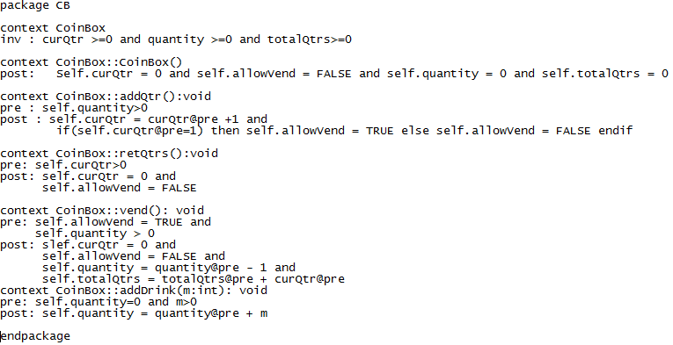
Automation and case study (Cont.)
Same Specifications in standard OCL format

Slide 20
Role of Our Approach (Cont.)
Automation
Our approach automates the process of Test Sequence generation.
Reading OCL specifications we automatically Construct
OCL Parse Tree and
Abstract Finite State Machine
Exhaustive Search Raw Test sequences and
Optimized Test sequences
This way the process of generating test sequences from standard OCL is automated all the way to the optimized test sequences.

Slide 21
Role of Our Approach (Cont.)
Optimization of Test Sequences
It is a novel approach that uses multi-objective GA for test sequence optimization, using a population of exhaustive search test sequences.
State of the art approaches random stochastic initial populations.
Due to random nature of GAs, such a population for test sequence generation might be disaster.
Starting with valid set of values and applying MOGA using our fitness functions yield more useful test sequences.

Slide 22
Comparison to the State of Art
As observed in the experimental case study for CoinBox:
Exhaustive state space search generated 872 test sequences
Of maximum length 26
With redundant test sequence loops
Unnecessary effort needs to be spent on executing all these test sequences
Application of MOGA with population size 10 and sequence length 15 gave
10 Test sequences
Of length 15 each
Which were optimized for all sate coverage and valid sequence paths
Since we used a random population out of the search based sequences, it minimizes the chances of bad genes and evolution in negative direction

Slide 23
Comparison to the State of Art
Mutation Analysis for 3 Classes
1000 Generations of Chromosomes
With JGAP default Mutation and Crossover rates.
Test Sequences contained to length 20
Over all quality of the test sequences assessed after complete evolution.
Class Under Test | Total No of Faults Seeded | No Faults identified by Previous Approach | Faults Identified by New Approach | Results
CoinBox | 117 | 81 | 97 | 8 more faults
Stack | 63 | 49 | 49 | Equal number of faults
Circle | 98 | 62 | 73 | 10 more fauts

Slide 24
Conclusion
Our new approach gives us following benefits over the previous one
Automation of test sequence generation process.
Conformance to Industry OMG standards OCL Syntax.
Optimization of Test Sequences:
Minimum number and
Higher quality test sequences
Saving the time and resources spent on a part of testing process
On the experimental data our approach seems either exceed or give at least equal defect revealing efficiency.

Slide 25
Conclusion (Cont.)
Future Work
By Nature, as of all optimization techniques, we get optimized solutions, there is always room on the top.
Evolution as a mimicry of the natural process of evolution might not find suitable chromosomes (e.g. due to mutation) and might give some useless test sequences.
After generation of AFSM we can investigation into the efficiency of these approaches my be done:
Generate a random population or
Get of population from raw sequences
Second option seems to give far better results.
While specifying MOGA Fitness Functions for Test sequence Optimization we must take into account the sequence of Genes while calculating fitness values.

Slide 26
References
An Approach for Class Testing from Class Contracts, Atul Gupta, Springer 2010.
Generating Feasible Test Paths from an Executable Model Using a Multi-Objective Approach, Thaise Yano et al, ICSTW, IEEE (2010).
Empirical study on the efficiency of search based test generation for EFSM models. Ruilian Zhao et al, 3rd International Conference on Software Testing, Verification, and Validation Workshops, IEEE (2010).
Optimizing for the Number of Tests Generated in Search Based Test Data Generation with an Application to the Oracle Cost Problem, Mark Harman et al, ISCTW, IEEE (2010).
Black-Box System Testing of Real-Time Embedded Systems Using Random and Search-Based Testing, Andrea Arcuri et al, IFIP International Federation for Information Processing (2010).
A Novel Approach to Generate Test Cases using Class and Sequence Diagrams, S. Asthana et al, IC3, Springer (2010).
A Systematic Review of the Application and Empirical Investigation of Search-Based Test Case Generation, Shaukat Ali et al, IEEE Transactions on Software Engineering (2010).
Optimization of Software Testing using Genetic Algorithm, S.K. Prasad et al, ICISTM, Springer (2009).
An Ant Colony Optimization Approach to Test Sequence Generation for Statebased Software Testing, S.K. Prasad et al, ICISTM, Springer (2009).
Automatic Test Case Generation for UML Object diagrams using Genetic Algorithm, M. Prasannan and K.R. Chandran, Int J. Advanced Soft Computing ICSRS (2009).

Slide 27
References (Cont)
A case study in model-based testing of specifications and implementations, T. Miller and P. Strooper, Wiley Internet Science (2007).
Automatic Test Case Generation for UML Activity Diagrams, Chen Mingsong et al, ACM (2006).
On Finding Multiple Pareto-Optimal Solutions Using Classical and Evolutionary Generating Methods, P. K. Shukla et al, Science Direct (2006)
Automated Unique Input Output sequence generation for conformance testing of FSMs, K. Derderian et al, The Computer Journal, ACM (2006).
Testing from Formal Specifications, a Generic Approach, Marie-Claude Gaudel, Springer (2001).
What Is Software Testing? And Why Is It So Hard? James A. Whittaker, IEEE SOFTWARE (February 2000).
Model-Based Testing in Practice, S. R. Dalal et al, Proceedings of ACM ICSE (1999).
No Silver Bullet Essence and Accidents of Software Engineering, F. P. Brooks, IEEE (1987)
Object Management Group (OMG)’s Formally Released versions of Object Constraint Language (OCL) available at http://www.omg.org/spec/OCL/
The Dresden OCL parser version 3.1. available at http://www.dresden-ocl.org/
Java Genetic Algorithm Package (JGAP) available at http://jgap.sourceforge.net
Metaheuristic Algorithms in Java (jMetal) an API for GA and MOGA based optimization, available at http://jmetal.sourceforge.net/

